Slide 1
Vaccination Station
Power BI dashboard for tracking key initiatives related to Epic’s goal to help customers reach herd immunity targets for COVID-19 vaccinations.
Combines project tracking, feature adoption, build, and vaccine administration data into one self-service tool.
Data Anonymized & Blurred For Confidentiality

Slide 2
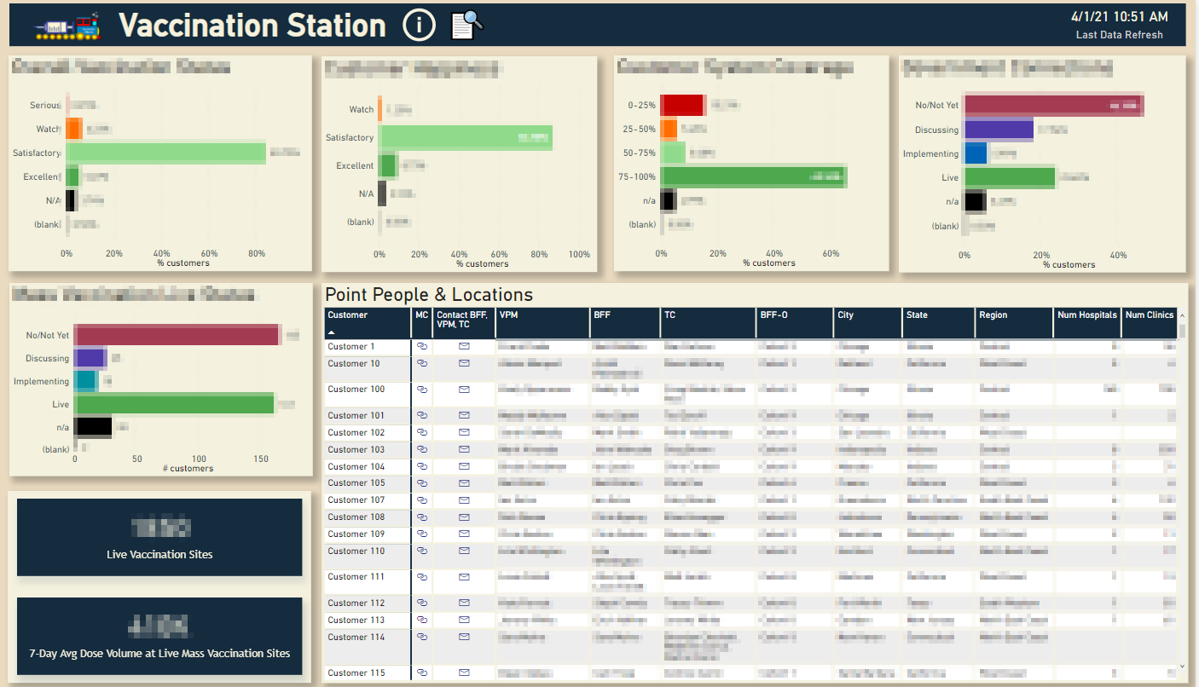
Snapshot
Project managers at Epic complete a weekly assessment to address key customer concerns related to COVID-19 vaccinations using an internal survey tool.
Key questions are summarized on the landing page of the dashboard to serve as leading indicators for customer success and escalation.
You can interactively filter out the customer list based on visualization categories or using a filter panel.
The customer details table includes a link to email key contacts for the customer

Slide 3
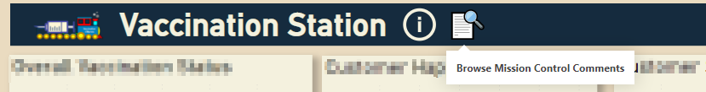
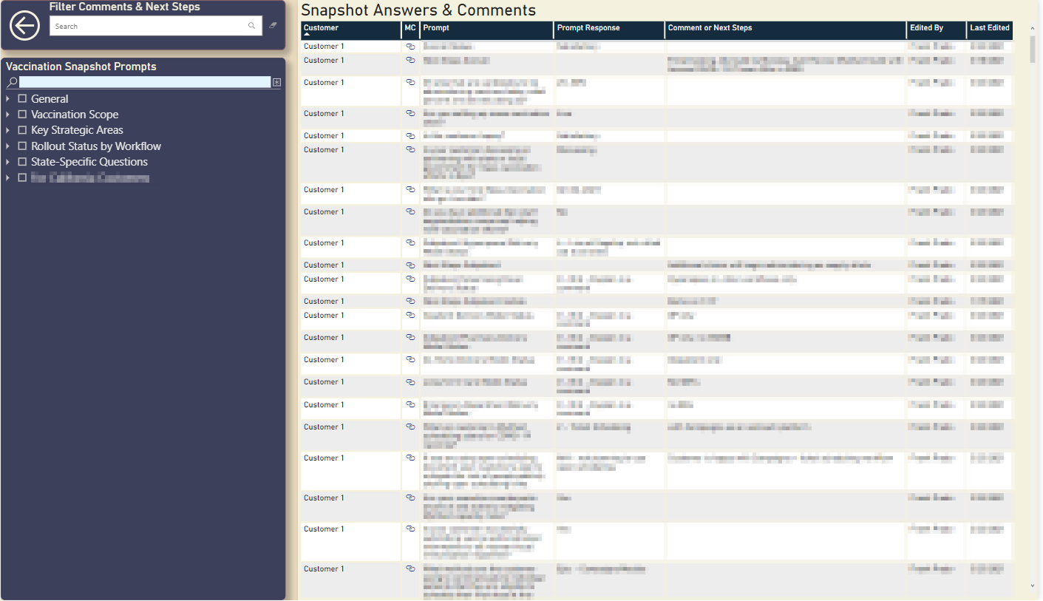
Snapshot Comment Browser
Not all snapshot questions are featured on the main page of the dashboard. To study answers and comments for all questions, you can navigate to the comment browser available as a link in the header
Note: Mission Control is an internal survey portal

Slide 4
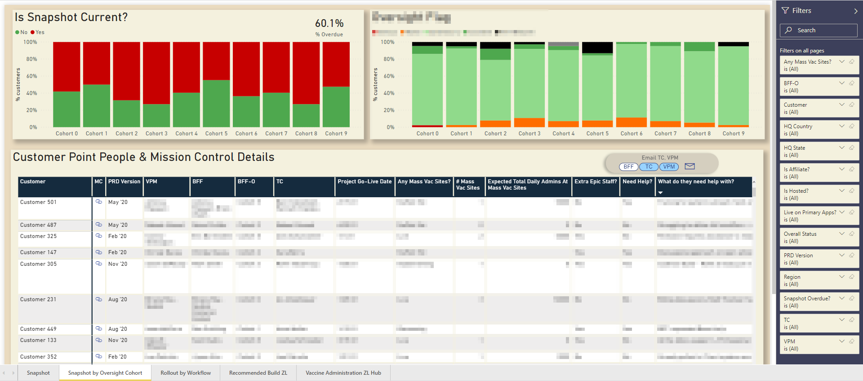
Snapshot by Oversight Cohort
Epic’s customers are subdivided into cohorts so that customer account executives can monitor groups of customers, follow-up up with customer teams and ensure customer success.
You can select customer roles so that you can generate a bulk email to all people with a specific role in your selected cohort of customers

Slide 5
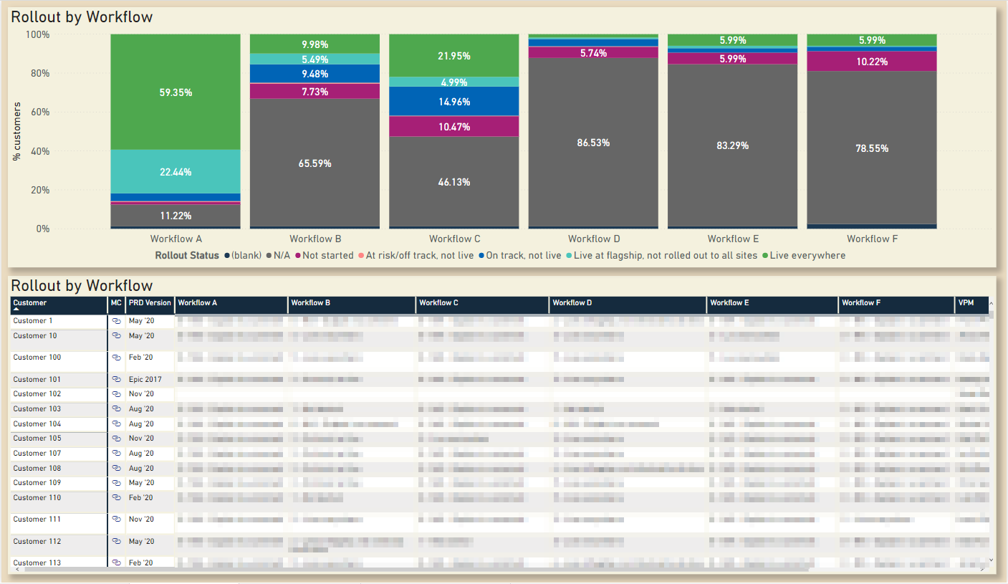
Rollout by Workflow
Customers need to prepare certain build based on the different workflows they could be using to coordinate vaccination efforts.
This page shows you the spread of customers by workflow implementation status across workflows and the ability to see line-level detail.

Slide 6
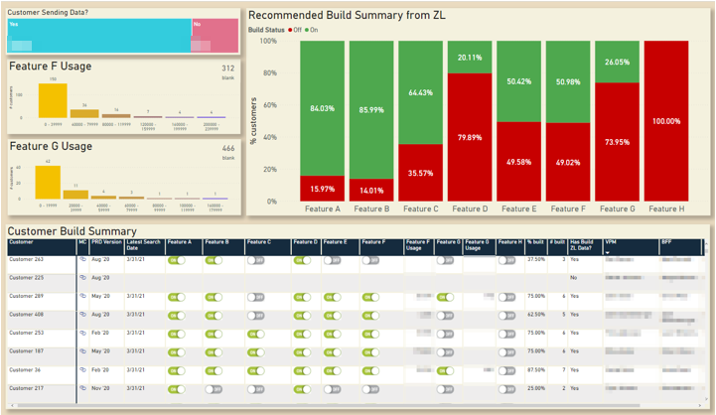
Recommended Build Summary
Set up an ad-hoc data collection pipeline to customer systems to determine if certain key features were turned on, since we believe these features could optimize customer vaccination workflows
Since this is an ad-hoc data process, we included a data completion visual to indicate who isn’t sending data
2 key features are highlighted by volumes associated with their use as this could indicate success and who may need help with server resources

Slide 7
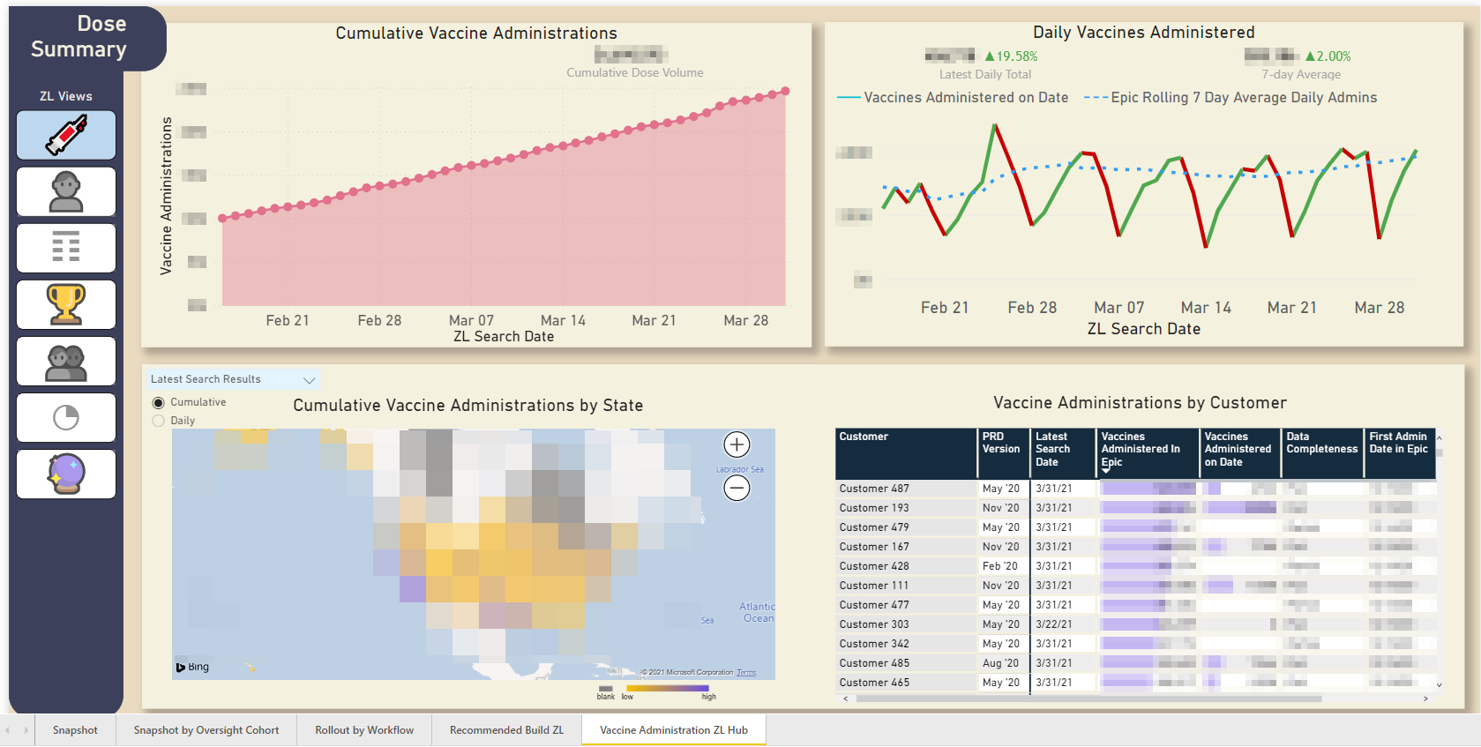
Vaccine Administration Hub - Doses
Track cumulative and daily vaccine administrations as documented in customer Epic systems
Visualize the data on a map and by customer to identify key trends. Can change these visuals to a previous search date.
Data collected via ad-hoc pipeline

Slide 8
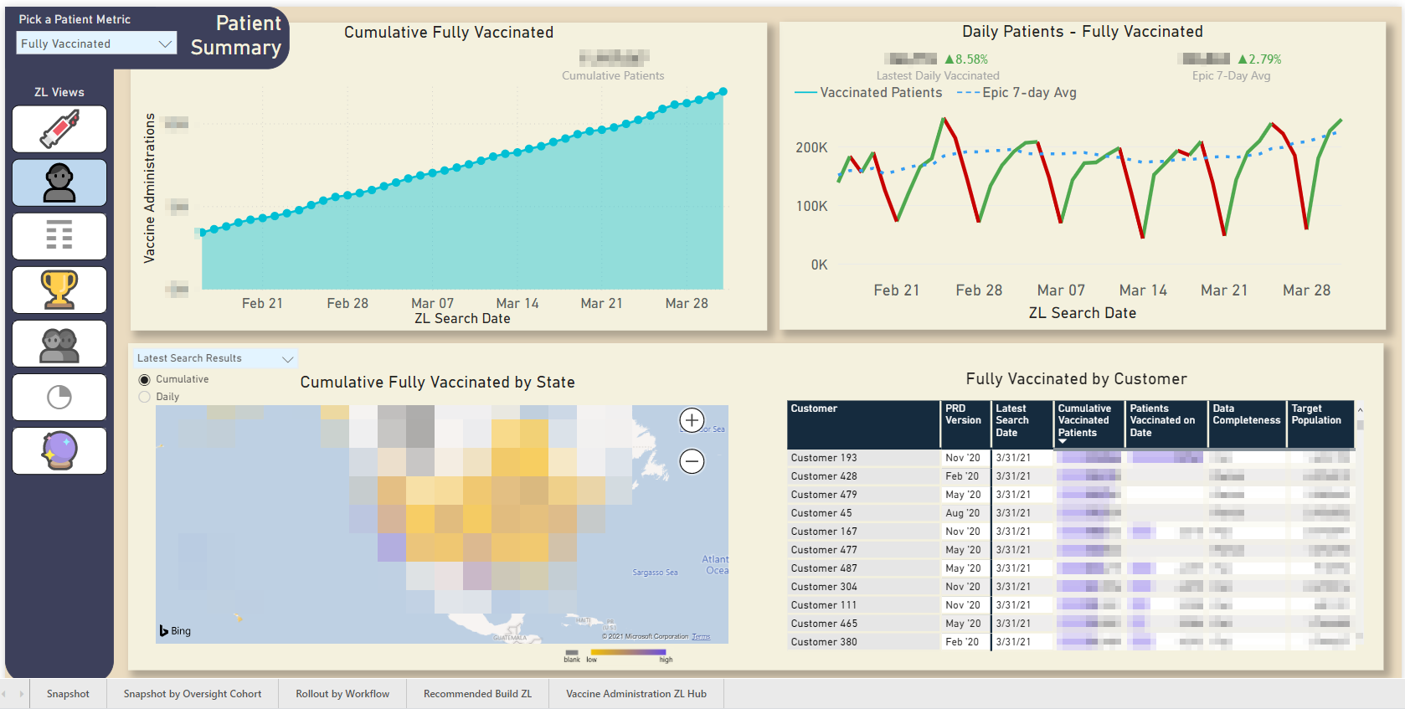
Vaccine Administration Hub - Patients
Track cumulative and daily patients who are vaccinated as documented in customer Epic systems
Toggle between different patient metrics like Fully Vaccinated and Patients with at least 1 dose
Visualize the data on a map and by customer to identify key trends. Can change these visuals to a previous search date.

Slide 9
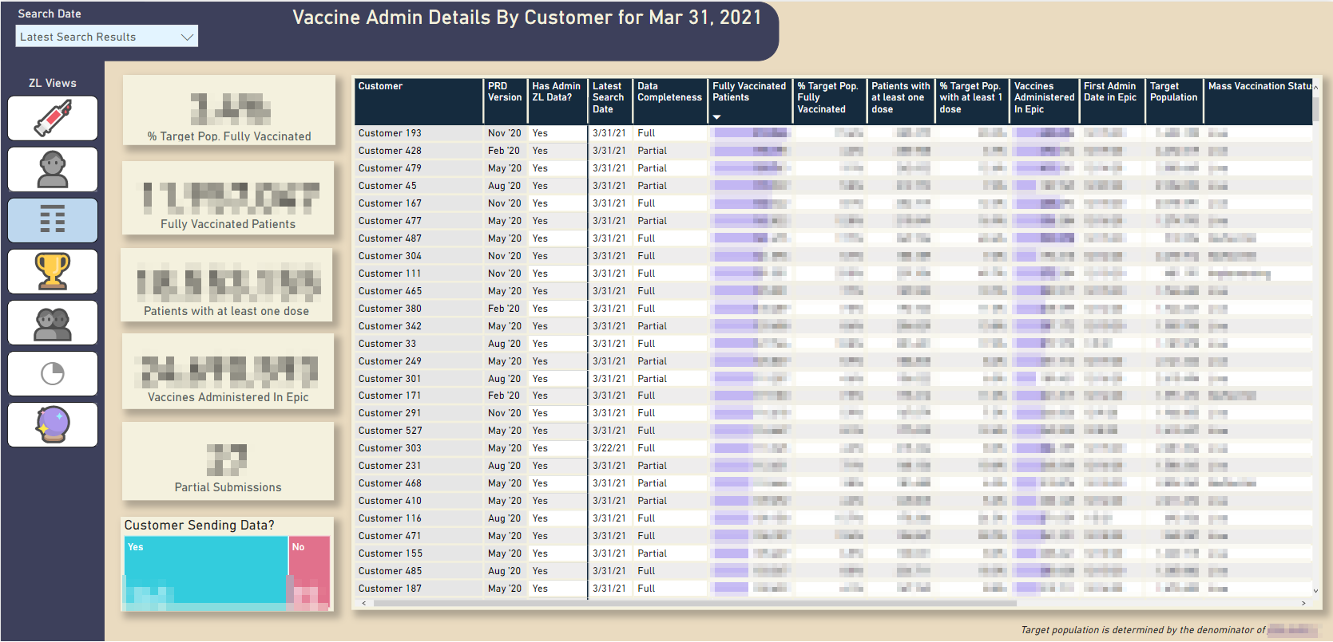
Vaccine Administration Hub - Details
Details table that allows you to filter by search date and view all overall administration metrics for each customer

Slide 10
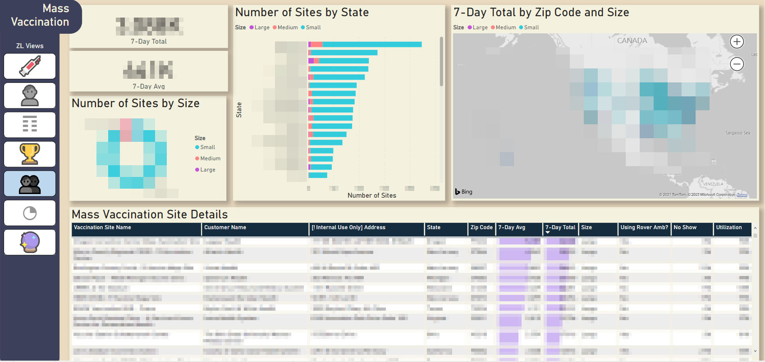
Vaccine Administration Hub – Mass Vaccination
Track customer mass vaccination site locations and volumes.
Mass vaccination sites are defined as places that are administering 1000+ vaccine doses/day
Customers are partnering with local organizations and officials to meet these goals and we need to know where volumes are shifting for these sites

Slide 11
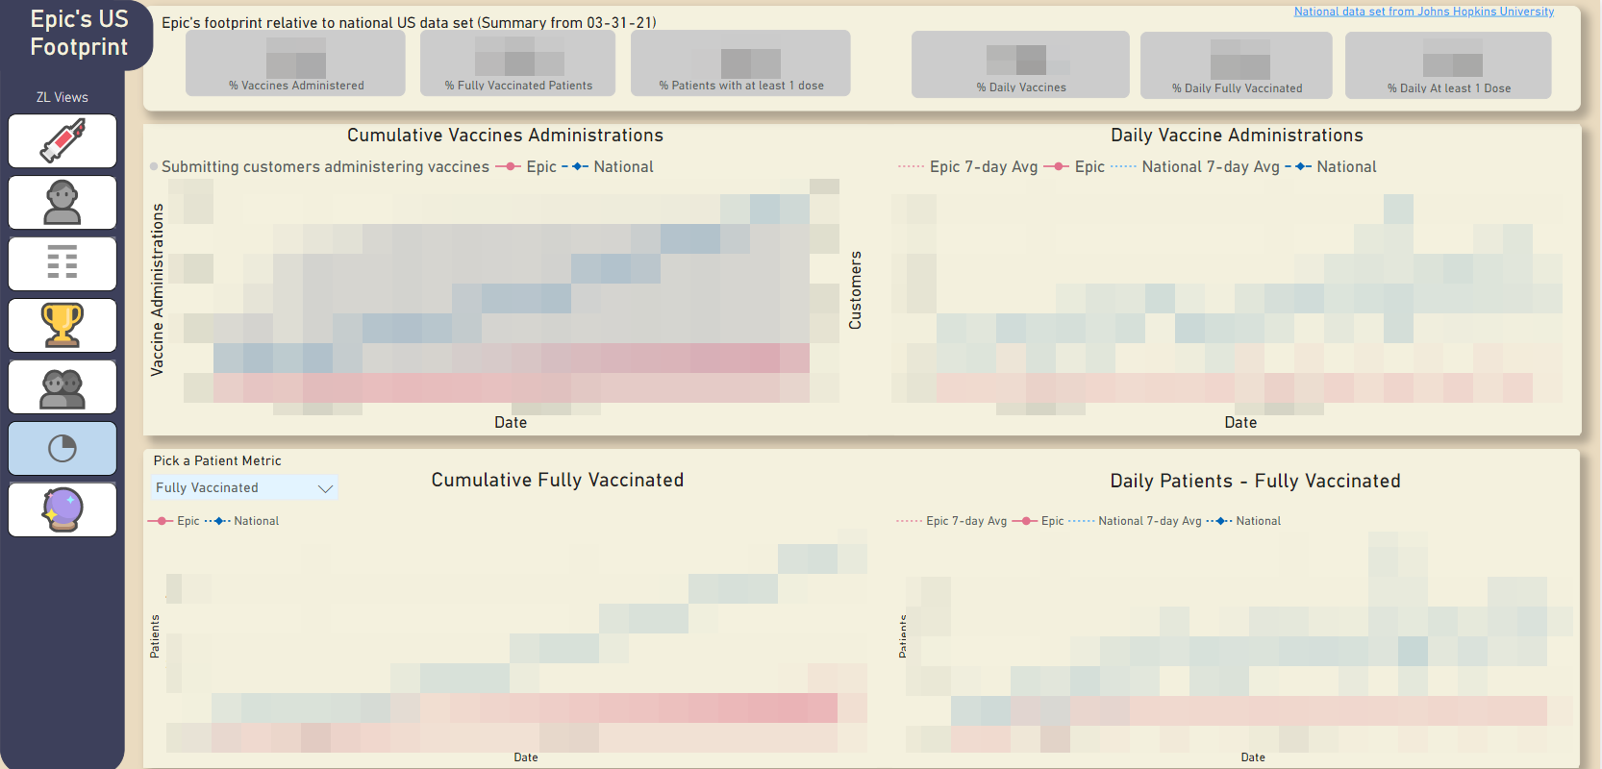
Vaccine Administration Hub – Epic’s US Footprint
Leaders want to know how much of the US vaccinated population and administration volumes can be attributed to data documented in Epic’s customer systems vs national data set overall
Set up a connection to John’s Hopkins GitHub repo to load national dataset daily into this report
Highly blurred for confidentiality, but these are trending line graphs that compare Epic volumes to the country overall
Just looking at Epic’s US customers

Slide 12
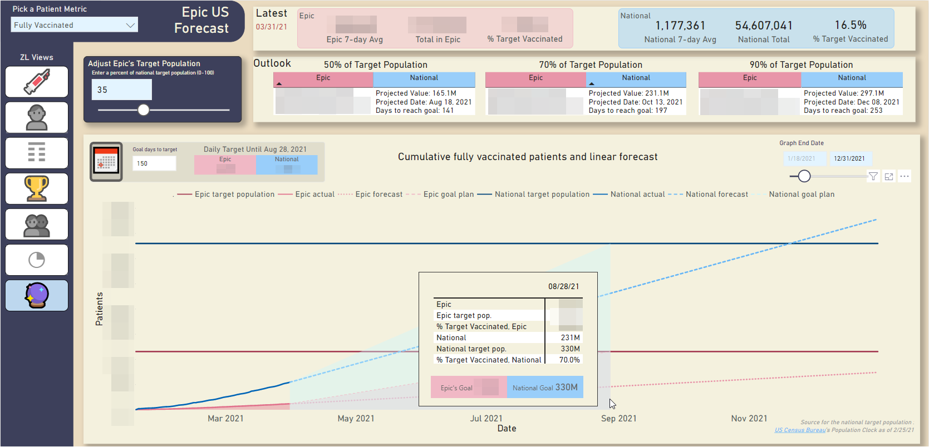
Vaccine Administration Hub – Epic US Forecast
Simple linear forecasts based on 7-day rolling average nationally and for Epic
Constant lines denoting target population - Epic’s target population can be adjusted using a slider to a certain % of the national population
Latest data cards and outlook cards out to 50, 70, 90% targets (how long would it take to hit these targets at the current rate?)
Optionally, set a goal end date to reach 100% target population. This will fill in the graph with a hypothetical scenario denoting the required daily average in order to vaccinate everyone by a target date
Comparing the linear forecast to the slope needed to vaccinate everyone by a specific date allows us to see how realistic the goal date can be compared to current trends.
Just using Epic’s US customers

Slide 13
Outcomes and Feedback
Cross-customer collaboration between struggling and successful customers
Increased compliance on snapshot completion with follow-up tools
Set up a standardized framework for ingesting ad-hoc customer data extracts into internal data warehouse
“This is my favorite dashboard ever! I can follow up with everyone I need to and get updated on my accounts in a heartbeat. THANKS!!!” – Customer Account Executive, Outpatient Clinicals
“Udbhav has been an absolute cornerstone of our efforts to track and report on both vaccination project statuses and metrics. He’s fast, organized, savvy to the available tools and able to effectively guide stakeholders to better strategies than what’ve come asking for. He often delivers more/better than what’s requested, and takes much appreciated initiative to create useful, insight-generating visualizations with minimal guidance” – Vaccination Project Lead

